Slide 1
Lobbying to Effect Change at the State Capitol
Presented by Rebecca Meyers
Contract Lobbyist, MACDS

Slide 2
Contact Information
Rebecca Meyers
Contract Lobbyist, Northbound Public Affairs
Helena, Montana
303.704.7350
rebecca@northboundpublicaffairs.com
www.northboundpublicaffairs.com

Slide 3
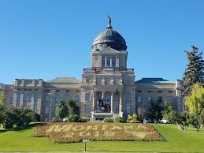
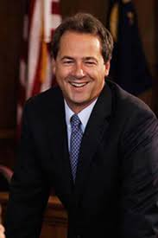
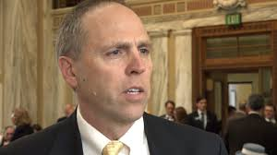
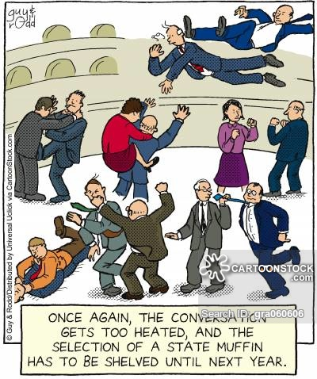
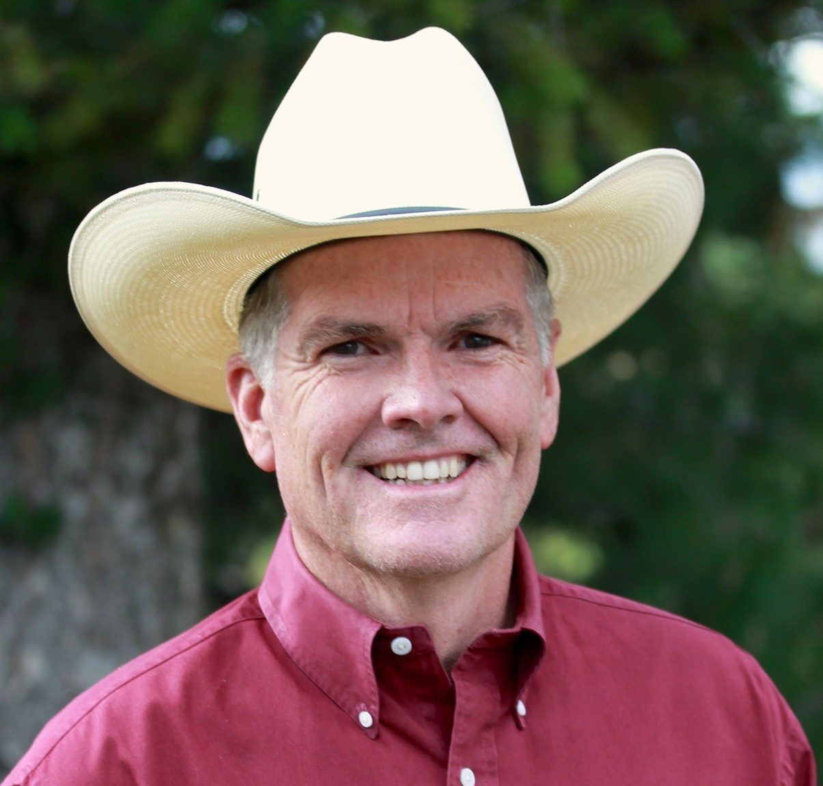
The Legislative Process: What happens inside the Capitol
150 Legislators
Republican Controlled House and Senate
Democratic Governor
Find your Legislator at www.votesmart.org or https://www.leg.mt.gov/
Notes:
General Assembly Makeup:
150 legislators
House of Representatives
100 Members
Elected to 2 year terms
About 1/3 turn over every election cycle
Senate
50 Members
Elected to 4 year terms
25 Hold Over Senators every election cycle
Term limits
We have them in theory but not in practice
Hop back and forth between Houses
The Legislature meets bi annually (odd year) for 90 days from January 4th through April 29th, 2021 (tentative).
“In accordance with 5-2-103, MCA, each regular session of the Legislature convenes on the first Monday in January of each odd-numbered year or, if January 1 is a Monday, on the first Wednesday.”

Slide 4
Leadership in Montana
Majority Party
Appoint chairpersons to Committees of Reference
Has majority of members on most committees
Determines Rules, Bill introduction, decorum, future legislative policies
Governor
President of the Senate
Speaker of the House
Majority and Minority Leaders of each chamber
Notes:
The President of the Senate, Speaker of the House of Representatives, and the Majority and Minority Leaders of each chamber serve as the primary leadership for the legislature. These eight members are responsible for the day-to-day operations of the House and Senate as well as serving as the oversight authority for the legislative service agencies.
Leadership is:
In control
Influential
Critical to develop relationships with
Ex: Mark Blasdel, Mary Caferro
Benefits of being Majority Party – dictate committee chairs/members; assign bills; allow bill introduction
https://leg.mt.gov/content/For-Legislators/Publications/legis-leadership.pdf

Slide 5
Legislative Process
Concept
Introduction of Bill
Committee Hearings & Amendments
Floor Vote
To the Governor’s Office
Implementation
Notes:
HANDOUT: How A Bill Becomes A Law
https://leg.mt.gov/content/For-Legislators/orientation/bill-becomes-law.pdf
Process:
Idea/identified problem
Viability
Appetite
Allies
Legislative vs regulatory changes
Sponsors - Get it on bill paper to introduce
Legislators and Deadlines
Feb. 20th - last day to introduce general bills
Feb. 27th – Transmittal Deadline
March 22nd – last day to introduce Appropriations/Revenue bills
Prior to committee hearing, my role as a lobbyist is to be collecting info, sharing info with MACDS, using Legislative Committees and leadership appointments to determine strategy and messaging
Process:
First reading (introduction) in House or Senate Floor.
Bill assigned to House or Senate Committee.
Public Hearing Scheduled in Committee.
Committee passes, kills, tables, or amends bill.
If bill passes, back to floor for Second Reading vote.
Entire Chamber debates, sometimes amends, and votes on the bill.
If bill passes second reading, it is placed on a Third Reading vote (no debate).
If bill passes third reading, it is passed to the other Chamber, and the process repeats.
If the second chamber amends the bill and the first chamber does not accept the amendments, the bill is sent to a conference committee (can only discuss the amendments) or a free conference committee (can discuss the bill in its entirety).
Conference committees are made up of legislators selected by leadership.
If a bill passes second Chamber, it is passed on to the Governor for action.
Governor can sign the bill, pass the bill without signature (10 days), amend, or veto a bill.

Slide 6
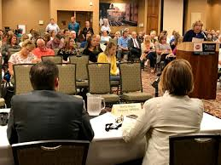
Committees of Reference Committees of reference, year-round committees, and interim committees consider legislation, provide oversight of executive branch agencies, and conduct studies on issues of importance to the state.
HOUSE COMMITTEES:
Appropriations
Human Services
Tax
SENATE COMMITTEES:
Business, Labor, and Economic Affairs
Public Health, Welfare, and Safety
Finance and Claims
Notes:
Chairpersons are from the Majority Party in that chamber
Size ranges from 5 to 19
Each bill is required to have one Committee hearing with public testimony – amendments can happen from this point on
Committees provide oversight of executive branches
Take place during different times
Excellent opportunity to message an issue
Amendments
Goal – Go into committee with an understanding of where the votes lie
Plant Questions/Offer Amendments
If the bill were to die in committee, what is the message you are wanting to send? Can we influence that message? Can we blast it back?
Target committee member to ask sponsor a question to ensure an opportunity presents itself to talk about something in particular
Using the Legislative Committee- great venue for talking through key messaging/personal outreach
Opportunity to build face time, credibility, influence

Slide 7
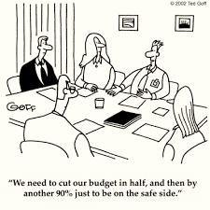
Policy vs Budget
Policy Bills/Legislation:
Assigned to standing committees
Great range of topics—earlier transmittal deadline
Budget and Appropriations
All funding must go through HB 2 or a Statutory Appropriation
H.B. 2: sorted into 6 different budget sub-committees
H.B. 2 follows long process before passage

Slide 8
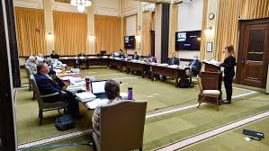
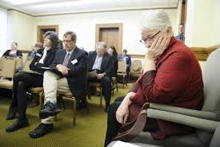
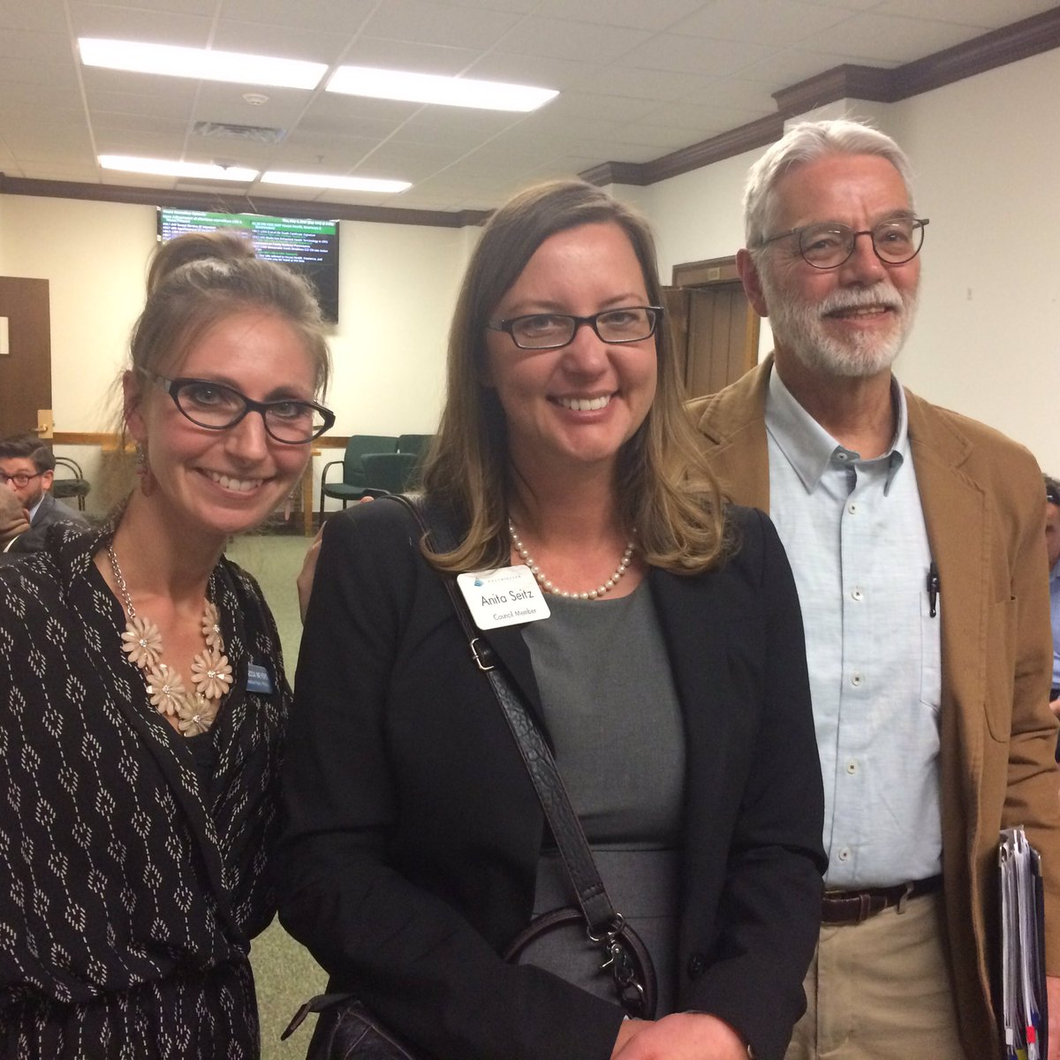
Public Testimony
Notes:
Explain the impact of a bill on an individual, group or community
Describe a desired amendment or a position on a proposed amendment
Ask questions of the bill sponsor(s) or committee members
Generate regular or social media coverage on an issue or bill
WHO TESTIFIES:
ANYONE with expertise on the topic who is (relatively) comfortable speaking:
Agency staff with experience and/or technical expertise on the issue
Witnesses from the districts the legislators on that Committee represent
Witnesses from the districts with legislators who are undecided; testimony from their community can make the difference
Humanize the issue
Testimony is perhaps the most meaningful step in the legislative process
Opportunity to speak directly to policy makers
Telling the story of an entire community which is unique to your position
My Job:
Prepare you as best as possible
Work through testimony/message
Prepare you for any potential questions or concerns
Etiquette
Great Visibility

Slide 9
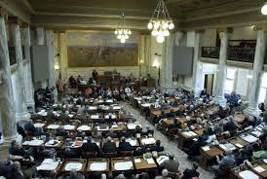
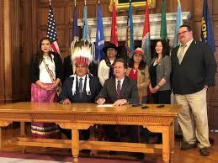
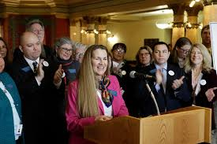
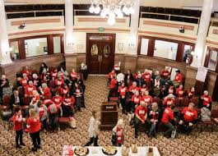
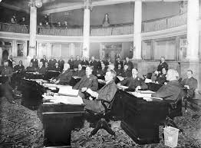
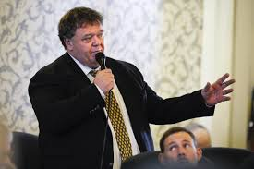
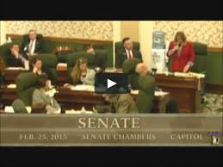
On The Floor
Notes:
Chance for the members to debate a bill
Occurs during 2nd reading
Prior to 2nd reading, I am:
Counting votes, listening for concerns, answering questions, preventing/offering amendments
Discussion and recorded vote
3rd reading – final vote in chamber
If the bill passes – heads to remaining chamber
Process may look different
May go to a different committee
Witnesses and testimony may be different
Strategy may shift depending on committee/majority leadership
Passed and signed by the Governor
Governor has veto power -10 days to veto; bill can become a law without his signature after 10 days

Slide 10
Road Blocks for Bills
Kill Committees
Bill will have a hearing but there is a predetermined outcome for legislation
Table the bill – no discussion
Notes:
No Bill is ever dead until Sine Die:
In Montana, a bill can be blasted back to a committee or to the floor for reconsideration.
Requires majority vote to do so and can happen at any time.

Slide 11
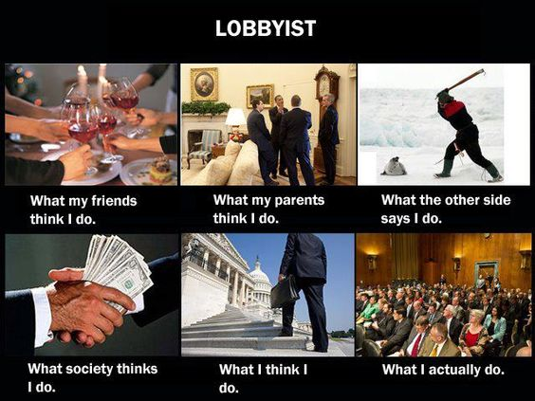
Benefits of a Lobbyist
LOBBY and LOBBYING means any communication with an official of the executive or legislative branch of State government for the ultimate purpose of influencing any executive, legislative, or administrative action.
Notes:
Serve as your liaison between policy makers, community partners, and you as individuals and advocates
Relationship development with General Assembly and Governmental Entities
Prepare witnesses in testimony, protocol, etiquette etc.
Advise on strategic planning, political feasibility, fiscal impact, and next steps
Increase organizational visibility
Push forward legislative priorities
Provide updates and understanding of issues impacting your work
Lobby General Assembly Members
Lobby State Agencies
What’s great about the entire process is that you don’t have to worry so much about all the little details for each step of the way. My job is to be your eyes and ears, on the ground, every day so that I can take information back to you all, strategize with you about how that impacts MACDS, and then work you on any messaging, talking points, testimony, or even just outreach.

Slide 12
Where You Come In
Meet w Legislators
Help Constituents Engage
Testify in Committee Hearings
Lobbying is just one piece of the larger Advocacy Pie
Local Engagement is just as powerful
Notes:
Speaking up matters.
Speaking cohesively and consistently allows for and encourages change
As community advocates, analysts, or policy makers, it is our public responsibility to stand up for your community’s needs, goals, and the well-being of individuals, communities, and our environment
If we don’t speak out, who will?
How does anyone know the problem when it’s not made known
Local Communities need to be understood and properly represented statewide and nationally for local change to occur
Without proper statewide policies in place, local communities may see barriers preventing them from implementing programs, procedures, goals, or comprehensive plans. (Need examples)
Budget line items
Communities need infrastructure in place to allow them to move forward

Slide 13
Opportunity for Action: Building the Relationship
Legislators are just like you and me.
Legislators in MT do not have staff.
You are talking to your legislators as a community leader.
Share how your job benefits your shared constituents.
If you are a provider, share the challenges and roadblocks you face.
Primary Concern – Provider Rate Increases; Access; Funding; Workforce.
Disabilities can impact anyone and does not discriminate between parties.
Legislators listen to their leadership, party caucus, constituents, and rely upon their own experiences and moral compass to make decisions.
Notes:
Handout: Welcome Letter
Send a letter of introducing yourself, your background, and your patients.
Ask Candidates and Legislators to coffee.
Invite legislators to your program for a tour and the opportunity to view how you operate (might not be possible in the time of COVID).

Slide 14
Opportunity for Action: Getting Involved
Communicate with your legislators
Get the right message to the right person at the right time – know policymaking process
Do your homework - Follow the 3 R’s
Make the issue Real – tell a story/personalize
Make the issue Relevant – how does this impact his/her constituents and local community?
Make the issue Right Now – what will happen if the legislation does not pass or pass?
Build trust and credibility by always telling the truth
Know the opposition
Follow-up and keep promises
Notes:
Get to know your legislators BEFORE the session.
Once the session starts legislators are bombarded with information and requests.
If you have established a relationship, your legislators will be more receptive to communication from you and will also likely consider you as a source of information.
Identify yourself, your organization, who you represent.
Be honest, friendly and never argumentative or confrontational – establish common ground.
Make it LOCAL.
Be Confident, Brief, and Respectful no matter how aligned you are.

Slide 15
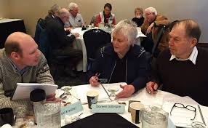
Feeling Prepared
Your Lobbyist and MACDS will work together to craft messaging and talking points when action is necessary.
You can add your local perspective – tell a story!
Feel ready to act by building rapport now.

Slide 16
MACDS 2021 Legislative Priorities
To implement an infrastructure support system using unutilized and inaccessible General Fund dollars already appropriated by the Legislature to the Developmental Disability Program.
These unused funds would be reserved to support:
Staff development;
Modifications for accessibility;
Property improvement;
Growing IT needs; or
Other provider infrastructure needs that directly impact the lives of members with disabilities.
Notes:
Handout: Priority Fact Sheet
Legislative Priority: Developing an Infrastructure Support System
The current rate of reimbursement for the developmental disability program is insufficient and does not provide enough retained earnings for providers to make these necessary adaptations to an aging infrastructure.
These funds may also have other unintended benefits of higher wages to staff as provider would not have to budget as much for maintaining group homes, congregate day center or apartment building used to house and care for individuals with developmental disabilities.
If providers had access to additional resources these could be used to provide a higher level of training which would reduce turnover, increase staff skills and expertise, and increase support to individuals with disabilities.
Regulatory Priorities (Non Legislative):
To establish a grant system for DDP to review and approve provider assessed needs and to allocate resources to the approved project.
To establish a process of accountability for how provider agencies prove to the DDP that the allocated funds we used for the approved purpose.
Long Term Priorities (3 Year Strategic Plan)
Addressing Provider Rate Increases
Develop and implement a coalition of multi service providers, legislative allies, and other invested parties to conduct research, compile data, and strategically build solution-oriented options to address provider rates long term. Coalition would be responsible for:
Define the need, shortfall, best case scenarios etc.
Looking at how other states have addressed the issue.
Researching funding opportunities.
Building awareness and understanding of the needs to lawmakers, State Agencies, the Governor’s Office, and other community leaders.
Developing long term, viable, solutions
2. Part C Protection
Work in partnership with DPHHS, Providers, Parents, and other stakeholders to develop a coalition to create and implement language, similar to Part B, that would protect Part C in Montana.

Slide 17
Additional Resources
Legislative Candidate List with Contact Information
Tips for Legislator Relationship Development
Who is your legislator?
Example Introductory Letter
Legislative Do’s and Don’ts
Agency Tours Do’s and Don’ts
Preparing to Testify
Campaign Contributions in Montana

